Slide 1
Penn State Worthington Scranton Challenges and Opportunities
Penny Carlson
Executive Director
Academic Services and Assessment

Slide 2
Topics
Profile of students
Demographic Projections
Challenges
Opportunities

Slide 3
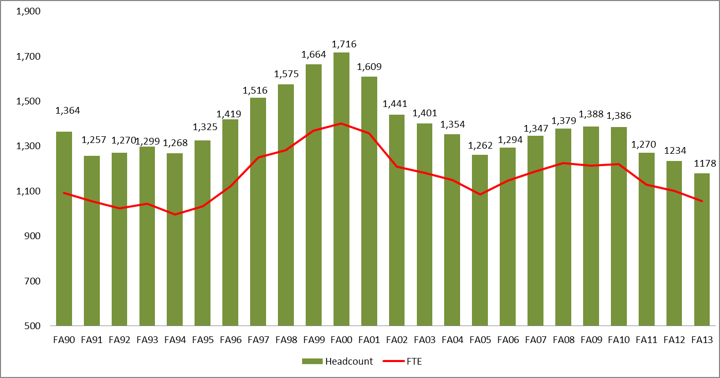
Worthington Scranton Enrollment Trend

Slide 4
Worthington Scranton Profile
1,178 fall 2013 official enrollment; 1,055 FTE
97% Pennsylvania residents; highest of any campus
80% attend full-time
72.5% traditional-aged (17-23)
47.5% are male
45% first-generation college students
16% from minority groups (25 % at CC in aggregate)

Slide 5
The campus serves students with modest income.
 | Median Family Income | Pell Recipients | Student Aid Recipients | Average Unmet Need
Worthington Scranton | $48,096 | 45% | 81% | $6,781
All Commonwealth Campuses | $54,743 | 38% | 82% | $7,810
University Park | $90,179 | 20% | 72% | $9,054

Slide 6
Students by Degree Type
Provisional | Non-degree | Associate | Baccalaureate
28 | 61 | 219 | 870
2% | 5% | 19% | 74%

Slide 7
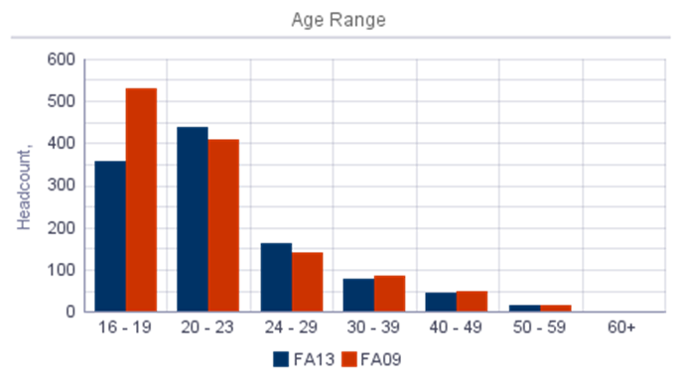
Growth areas include students ranging in age from 20 to 29.

Slide 8
Campus is experiencing growth in minority groups.
Race/Ethnicity | FA09 | FA13
American Indian or Alaska Native | 5 | 1
Asian | 21 | 52
Black or African American | 17 | 31
Hispanic/Latino | 40 | 51
International |  | 8
Native Hawaiian or Other Pacific Islander |  | 1
Race/Ethnicity Unknown | 51 | 17
Two or More Races | 15 | 18
White | 1,075 | 910
Grand Total | 1,224 | 1,089

Slide 9
Challenges
National attention to gainful employment, student debt, etc.
High PSU tuition cost
Responding to the demographic decline
Increasing market share
Providing assistance to students with poor preparation
Adjusting to the advanced technologies

Slide 10
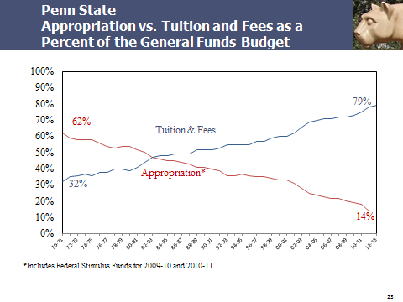

Slide 11
Strategies to assist students and to enhance yield on offers will continue.
Further tuition differential at campuses
Increased institutional support for scholarships
Provost
Chancellor
Campus designated funds

Slide 12
The market for traditional college- aged students is declining.

Slide 13
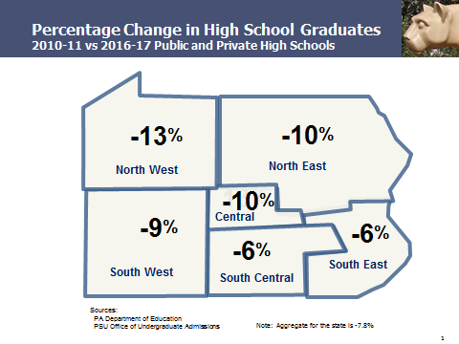

Slide 14
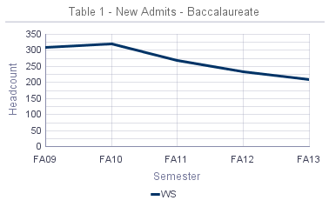
New Baccalaureate admits have declined.

Slide 15
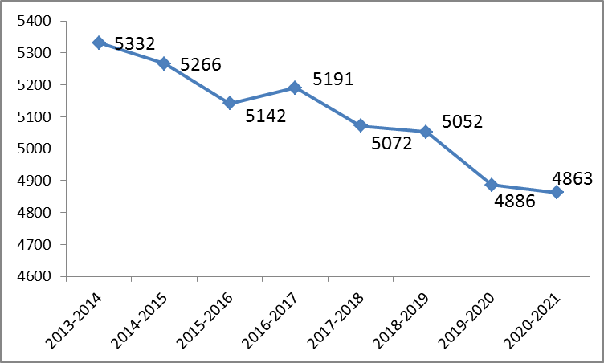
The decline in high school graduates within the PSWS service area is projected to continue through the decade.
Source: PA Department of Education

Slide 16
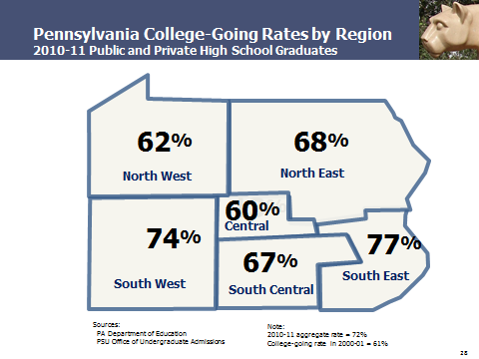

Slide 17
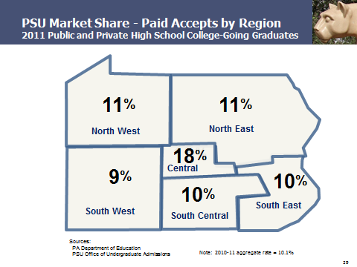

Slide 18
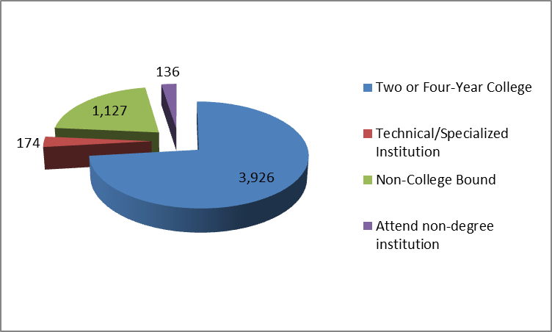
The majority of PSWS service area students are attending two and four year schools.

Slide 19
Non-traditional pathways
Thirty percent of service area population (29,208) has some college but no degree.
Worthington Scranton has experienced growth at the upper level in baccalaureate programs delivered.
Advanced standing new admits are increasing.

Slide 20
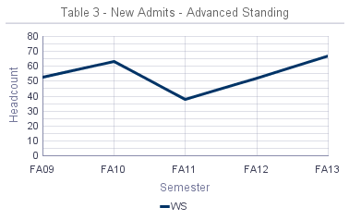
Advanced standing students are increasing.

Slide 21
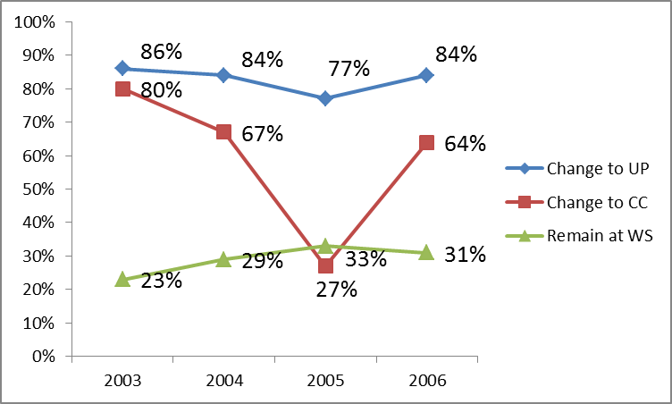
Graduation Rates
Source: OPIA Six-Year Graduation Study

Slide 22
One year later… Fall 2011 to 2012 Fall
1270 – total enrollment
49% (676) remained at WS
27% (347) not enrolled at PSU
2% (27) transferred to a 2-year school
5% (60) transferred to an 4-year school
13% (161) graduated
8% (97) transitioned to UP
2% (27) transitioned to a CC campus

Slide 23
Academic Performance of fall 2012 new students
Total 367 students
17% (63) earned a GPA below 2.0
85% ( 299 ) earned fewer than 27.1 credits
5,324 credits earned in aggregate
1,125.5 credits received grades of D, F or W.

Slide 24
New technologies are demanding change.
Building capacity and supporting faculty who teach online
Adapting to new technology systems:
Project LionPath
Course Substitution and Request System
Certified Background Checking
Alek

Slide 25
Opportunities
Maximum pathway for students with some college and no degree
Continue to enhance diversity on campus
Add new undergraduate programming based on market demand and student interest
Build capacity for blended and online instruction
Collaborate with other campuses both in and out of the region

