Slide 1
Artificial Intelligence
Writing Tools
Chris Millet, Senior Director of Learning Design, World Campus
Wendy Mahan, Director of Learning Design, College of the Liberal Arts

Slide 2
Presentation Outline
AI Writing Work Group and Purpose
Background on AI Writing Tools
Impact on High Education Assignments/Assessment
Discussion on Academic Integrity Issues

Slide 3
Will artificial Intelligence Kill College Writing?

Slide 4
AI Writing Work Group and Purpose
Working Group of Penn State Online Coordinating Council (Charged October 2022)*
Primary Goal: Investigate issues related to AI and Academic Integrity (AI²)
Deliverables include:
Recommendations for Academic Integrity definitions, policies and procedures.
Guidance for the design of assignments and assessments.
Faculty Development resources
* Working Group charge written by GPT3-based writing tool

Slide 5
AI Writing Membership
Chris Millet, World Campus (co-chair)
Wendy Mahan, Liberal Arts (co-chair)
Andrew Peck, Professor of Psychology, Assoc. Dir. Of Undergraduate Studies
Beth Parfitt, Assoc. Prof. English, Scholar in Residence at Penn State Learning
Karen Feldbaum, Assoc. Director of Judicial Affairs
Shayam Sundar, Director, Center for Socially Responsible AI
Stuart Selber, Professor of English
Russel Harrison, Student & Penn State Learning Writing Center staff
Kristen Camplese, Instructional Design, College of Business
Michelle Baker, Asst. Professor, Director of eLearning Initiatives
Kenneth Huang, Asst. Professor, College of IST
Lisa Lenze, Director of Learning Design, College of IST
Stevie Rocco, Director of Learning Design, College of EMS
Susan Loy, Instructional Designer, Harrisburg
Adam Smith, Asst. Research Professor, Schreyer Institute for Teaching Excellence
I-Pang Fu, Director of Learning Design, Penn State Law

Slide 6
AI-Assisted Writing Tools Overview

Slide 7
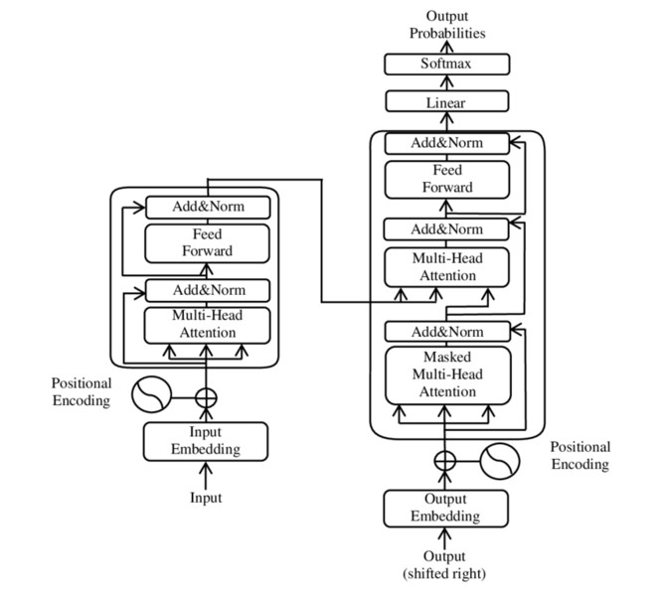
Generative Pre- Trained Model (GPT)
Transformer Models
Research from Google
Processes sequential data (like language)
Allows us to train on very large datasets
Generative
Use model to generate new data that looks right (e.g. predict next token (word) in a sentence)

Slide 8
OpenAI, GPT3.x, and ChatGPT
OpenAI
Co-founded by Elon Musk in 2015 (resigned from board)
Microsoft invested $1B in OpenAI
GPT3.x
GPT is a language prediction model trained on very large data sets.
Training data is ~3.1 billion documents (webpages, books, research articles) -> 175B parameters
GPT 3.5 powers ChatGPT
It can produce human-sounding text, given a topic (i.e. it predicts what you might say about that topic)
It is very very good at what it does. Maybe indistinguishable, even better, than what a human can write.
https://chat.openai.com

Slide 9
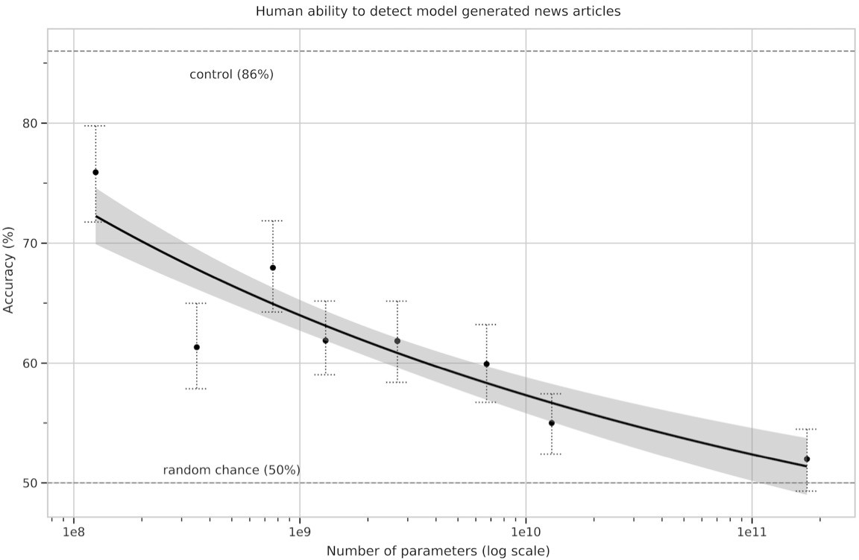
Why do parameters matter?

Slide 10
Current Tools
ChatGPT (Open AI)
Released at the end of November 2022
Answers questions through back-and-forth dialogue
Produces high-quality, human-like writing
May give inaccurate information
Will admit mistakes when questioned (and learn from them)
Many Similar AI Writing Tools: Moonbeam, Jasper, Copysmith
Social media chatter strongly indicates these tools are already being heavily used in Higher Ed
Related Tools: DALL-E (images), Midjourney (images), CoPilot (coding)

Slide 11
Soon-to-be-Released AI Tools
WebGPT (Open AI)
Addresses accuracy of ChatGPT’s responses
Trained on more recent data
Cites sources in responses
PaLM (Google)
Greater performance and accuracy than ChatGPT
Uses combination of English and multilingual databases
Draws from web documents, books, Wikipedia, conversations and GitHub code

Slide 12
Impact on Higher Education
Faculty Reactions/Concerns/Time
Design of Assignments and assessments
Academic Integrity

Slide 13
Example 1: Undergraduate History Course
Compose a short response essay (500 words) about The Deeds of Divine Augustus. Your essay should contain a thesis statement, evidence from the text (with proper citations from the primary source, textbook, and/or lesson readings), and a conclusion. You may choose to respond to one or more of the following topics, or decide on one of your own:
How does Augustus wish the Roman people to see him? How does he buttress this impression with “evidence”?
In what ways does Augustus work to shape the public perception and memory of his former enemies?
In what ways do we find Augustus presenting false or biased information about the problematic events of his past?

Slide 14
ChatGPT Prompts (Example 1)
Prompt 1:
Compose a 500-word essay containing a thesis statement, evidence from the Res Gestae Divi Augusti and a conclusion that responds to the following questions: How does Augustus wish the Roman people to see him? How does he buttress this impression with “evidence”? In what ways does Augustus work to shape the public perception and memory of his former enemies? In what ways do we find Augustus presenting false or biased information about the problematic events of his past?

Slide 15
AI Sample
In the Res Gestae Divi Augusti (The Deeds of the Divine Augustus), Augustus presents himself as a benevolent and wise leader who has brought peace and prosperity to Rome. He uses a variety of tactics to buttress this impression, including highlighting his military victories, his administrative accomplishments, and his moral virtues. Augustus also works to shape the public perception and memory of his former enemies by presenting them as threats to Rome and emphasizing his own role in defeating them. However, a closer examination of the text reveals that Augustus is presenting false or biased information about the problematic events of his past in order to present himself in the best possible light.
Augustus' primary goal in the Res Gestae is to present himself as a heroic and benevolent leader who has brought peace and prosperity to Rome. He emphasizes his military victories, including his campaigns against the Gauls, the Cantabrians, and the Dalmatians, and his naval victory over Sextus Pompeius. Augustus also highlights his administrative accomplishments, such as his construction of public buildings and his distribution of land to the poor. He presents himself as a moral and just ruler, citing his pardoning of political opponents and his refusal to accept public honors that were deemed excessive. Through these various tactics, Augustus seeks to portray himself as a wise and virtuous leader who has brought peace and stability to Rome.
In addition to presenting himself in a positive light, Augustus also seeks to shape the public perception and memory of his former enemies. He portrays these enemies as threats to Rome and emphasizes his own role in defeating them. For example, Augustus presents Mark Antony as a selfish and ambitious man who was defeated in battle because of his own failures. He also portrays Brutus and Cassius, the assassins of Julius Caesar, as disloyal and treacherous men who were justly punished for their crimes. By portraying his enemies in this way, Augustus seeks to cast himself as the hero who saved Rome from these threats.

Slide 16
AI Sample 2
However, a closer examination of the Res Gestae reveals that Augustus is presenting false or biased information about the problematic events of his past in order to present himself in the best possible light. For example, Augustus portrays his defeat of Mark Antony as a great military victory, but in reality the two men had already reached a power-sharing agreement before the battle took place. Augustus also portrays himself as a just and moral ruler, but in reality he was willing to use violence and intimidation to maintain his power. Additionally, Augustus presents the assassination of Julius Caesar as a crime that was justly punished, but he fails to mention his own role in the conspiracy. These and other examples suggest that Augustus is presenting a highly selective and self-serving account of his own actions and accomplishments.
In conclusion, the Res Gestae Divi Augusti shows that Augustus seeks to present himself as a benevolent and wise leader who has brought peace and prosperity to Rome. He buttresses this impression with evidence of his military victories and administrative accomplishments, and he shapes the public perception and memory of his enemies by portraying them as threats to Rome. However, a closer examination of the text reveals that Augustus is presenting false or biased information about the problematic events of his past in order to present himself in the best possible light.
Sources:
Augustus, "Res Gestae Divi Augusti."

Slide 17
Faculty Feedback (Example 1)
The AI composes essays that are both grammatically and stylistically correct. All components of a formal essay are present from the thesis statement to the supporting paragraphs and conclusion. It has trouble, however, with specific evidence. It is obviously not "reading" the document.
The first two paragraphs are more or less fine.
Beginning in paragraph three, however, the AI begins to make mistakes that, as an instructor, I would flag for problems. The contents of paragraphs 3 and 4 are simply wrong.
Augustus does not mention ANY of his enemies by name. He refers to them obliquely, often through misleading information.
AI's claims in paragraph four that before the battle with Antony, Augustus had reached "power- sharing agreement" with him, and the suggestion that Augustus had some role in the senatorial conspiracy against Julius Caesar are both just flagrantly incorrect.

Slide 18
Example 2: Undergraduate History Course
After you have read The Twelve Tables, follow these steps to complete this assignment:
Compose a short response essay of at least 400 words detailing what your chosen source tells us about Roman government and society in its respective time period.
Consider the genre, historical context, and purpose of the writing.
Include evidence from your readings (with proper citations) to back up your points. Feel free to note anything that you find interesting or surprising!

Slide 19
ChatGPT Prompts (Example 2)
Prompt 1:
Compose a short response essay of at least 500 words detailing what The Twelve Tables tells us about Roman government and society in its respective time period. Be sure to consider the genre, historical context, and purpose of the writing.
Prompt 2:
Using both Boatwright, M.T., Gargola, D.J., & Talbert, R.J.A. (2004) and Livy (n.d.) as sources, rewrite your response.

Slide 20
AI Sample 3
The Twelve Tables is a set of laws that were inscribed on twelve bronze tablets and displayed in the Roman Forum in the 5th century BCE. These laws, which were written in Latin, were the first attempt by the Roman Republic to codify its laws and make them accessible to all citizens (Boatwright et al., 2004). The Twelve Tables reflect the values and concerns of Roman society during this time period and provide insight into the government and legal system of ancient Rome.
According to Boatwright et al. (2004), the Twelve Tables were the result of a long process of legal reform in Rome. In the early years of the Republic, Roman law was largely based on custom and tradition, and there was no formal system of law or legal code. As Rome grew in size and complexity, however, the need for a more organized and standardized legal system became evident. The Twelve Tables were the result of this need, and they represented a major step forward in the development of Roman law.
Titus Livy, a Roman historian, also discusses the Twelve Tables and their importance in the development of Roman law. According to Livy, the Twelve Tables were the result of a long process of legal reform in Rome, which began in the early years of the Republic. In order to address the need for a more organized and standardized legal system, a commission was appointed to compile a code of laws that could be applied equally to all citizens. The result of this effort was the Twelve Tables, which provided the first systematic and comprehensive legal code for the Roman Republic (Livy, n.d.).
One of the most striking aspects of the Twelve Tables is the attention they give to the rights and responsibilities of Roman citizens. The tables contain provisions related to a wide range of legal matters, including property rights, contracts,
inheritance, and criminal law. For example,
Table VIII
contains provisions related to the sale and transfer of property, while
Table IX
deals with inheritance and the distribution of a deceased person's property (Boatwright et al., 2004). These provisions
reflect the importance of property and wealth in Roman society and the importance of legal protections for these things.

Slide 21
AI SAMPLE 4
In addition to addressing the rights and responsibilities of citizens, the Twelve Tables also provide insight into the government and political structure of ancient Rome. The tables contain provisions related to the organization and operation of the Roman courts, as
well as the powers and duties of Roman officials. For example,
Table V
contains provisions related to the procedures for bringing legal
cases before the courts, while
Table VII
deals with the powers and duties of Roman magistrates (Livy, n.d.). These provisions reflect the
importance of the rule of law in Roman society and the role of the courts in upholding justice.
The Twelve Tables also provide insight into the social and cultural values of ancient Rome. For example, the tables contain provisions related to marriage and family law, including the rights and responsibilities of married couples and the rights of children (Boatwright et al., 2004). These provisions reflect the importance of family and marriage in Roman society and the legal protections that were afforded to these institutions.
In conclusion, The Twelve Tables tells us a great deal about Roman government and society in its respective time period. The tables provide insight into the legal system, the rights and responsibilities of citizens, the government and political structure, and the social and cultural values of ancient Rome. These laws reflect the values and concerns of Roman society during this time period and provide a valuable resource for understanding the history and development of Roman law.
References:
Boatwright, M.T., Gargola, D.J., & Talbert, R.J.A. (2004). The Romans: From Village to Empire. New York, NY: Oxford University Press.
Livius, T. (n.d.). History of Rome from its Foundations. Translated by Rev. Canon Roberts. Retrieved from http://www.thelatinlibrary.com/livy.html

Slide 22
Faculty Feedback (Example 2)
Original Prompt:
The Twelve Tables essay is wonderfully written.
One grammatical error seem to suggest that AI is reading about the Twelve Tables rather than reading the document itself.
It does not switch to the present tense when discussing what the document contains. This grammatical error reflects the main problem with the AI, which is that it does not provide examples from the text. I suspect that it draws on what others have written about the text online.
Second Prompt after Feedback:
In-text citations and source listed.
Grammar suggest that AI is reading the Twelve Tables.
Provides specific examples from the Twelve Tables.
In-text citations from course textbook, but they are either very general or inaccurate.

Slide 23
Example 3: Psychology Grad Course
Discussion Assignment
Your required reading, Aagaard (2017), described the fuzzy front-end of radical innovation (FEI) as a unique and highly specialized phase of innovation. FEI requires the support of unique leader behaviors and human resource management (HRM) practices.
What is one HRM practice mentioned in the Aagaard reading that surprised you? Why?
Could you see that practice being used in your organization? Why or why not?
ChatGPT Prompt
What practice in Aagaard (2017) fuzzy front-end of radical innovation is surprising and could be used with HRM in my organization?

Slide 24
AI Sample 5
One practice in Aagaard (2017) fuzzy front-end of radical innovation that could be surprising and useful for HRM in an organization is the emphasis on fostering a culture of creativity and innovation. According to Aagaard, the FEI is characterized by a high degree of uncertainty and complexity, and organizations must be willing to embrace new and innovative ideas in order to succeed. One way to facilitate this process is by fostering a culture of creativity and innovation within the organization.
HRM can play a key role in fostering this culture by creating an environment that encourages employees to think outside the box and by providing them with the resources and support they need to generate and test new ideas. This could include things like offering training and development opportunities that focus on creative problem-solving and innovation, providing employees with the time and space to brainstorm and collaborate on new ideas, and establishing processes for evaluating and rewarding creative and innovative thinking.
Overall, fostering a culture of creativity and innovation within an organization can be a powerful way to stimulate radical innovation and drive organizational success. By embracing this practice, HRM can help to create an environment that encourages employees to think creatively and to take risks, which can ultimately lead to the development of new and innovative ideas that can drive organizational growth and success.

Slide 25
Faculty Feedback (Example 3)
The essay mentions general HRM practices, rather than the specific ones discussed in the
article. The impacts of HRM practices are discussed in general terms, rather than citing
specific results from the article.
The essay does not discuss how an HRM practice could be applied in a specific
organization, i.e., where the student works.
That being said, if an instructor rushed through their grading without carefully reading
the article, then it's possible the student would receive an 8 or a 9, maybe losing a point
or two for not mentioning their own organization.
So the bottom line is that the burden is on instructors to design authentic assessments
and carefully evaluate student submissions.

Slide 26
Example 4: Psychology Grad Course
Write a short paper (2-4 pages, Times New Roman, 12 pt font, double-spaced; cover and references pages are not included in page count) in which you briefly describe your organizational situation, explain the problem in your own words, and analyze the implemented solution.
There should be five main sections of your paper. Include the following:
Situation Description: Briefly highlight relevant parts of the scenario.
Model Summary: Identify the creative process model. Briefly describe each stage and explain its purpose. Be sure to explain in your own words and cite the source(s) of your information. Contextualize the information. In other words, make it specific to Interface’s situation and Anderson’s identified need/opportunity to do business differently.
Problem Diagnosis: Identify pitfalls that Anderson and his team likely faced within specific creative process stages. If possible, provide real information to illustrate experienced challenges.
Solution: Using your knowledge of the creative process, analyze and evaluate the steps that Anderson and Interface followed to develop their innovative approach to business. Were any creative traits or skills evidenced in the stories and sources you reviewed about Anderson and Interface?
Lessons Learned: Present lessons that you — or other leaders — could learn from this case study. What conclusions can you
draw about challenges and benefits of innovative leadership?

Slide 27
Open Questions
Instructor Role: What are we asking students to write? How are we reading and responding--not just grading, but responding--to writing?
Assignment Design: How are we assigning writing? How do we use writing in our classrooms? What is
the purpose of writing assignments? Is it simply to recall knowledge that can be pieced together (using AI?) or are we using the writing to think through ideas in some way?
Preparing Students: How do we train students to be at the forefront of AI knowledge? If this is the future
of the workforce, it’s important to consider how we train students for that workforce.
Academic Support: we want to educate students on how these tools work--not just tell them not to use them. For example, Grammarly is a great tool, but it often makes stylistic recommendations that are not grammatical rules. They are powerful tools, but writers still need to know when a suggestion is a rhetorical choice or necessary for accuracy and comprehension. We might consider how students can use GPT3 to help them learn about public conventions of writing and language.
Process vs. product: Teaching writing is often about process--and the end goal is not expected to be
“perfect.” How might the writing process become more explicit in our classrooms?

Slide 28
Redesigning Assignments/Assessments 1
Reduce student use of AI in Assignments
Use authentic assessments where students apply what is learned to their unique situation (i.e., work environment).
Use a semester-long or unit-long assignment where the student builds on each assignment, revising submissions in response to instructor feedback.
Create discussion prompts and rubric criteria that go beyond surface-level learning responses.
Have students apply concepts to local issues or current events.

Slide 29
Redesigning Assignments/Assessments 2
Incorporate AI into Assignments
Enhance transfer of knowledge through providing varied AI-generated examples (new situations, case studies, etc.) for the students to analyze, rank or critique.
Place student in the role of the teacher or peer reviewer, where they evaluate the quality of essays, reports or short stories generated by AI. They can be asked to add to, improve, correct the information.
Have the students create a process or timeline with AI and then ask them to add a step, delete a step, determine the need for additional information, etc.

Slide 30
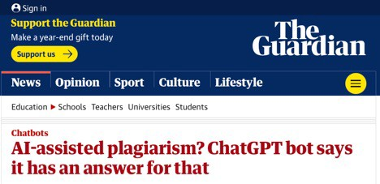
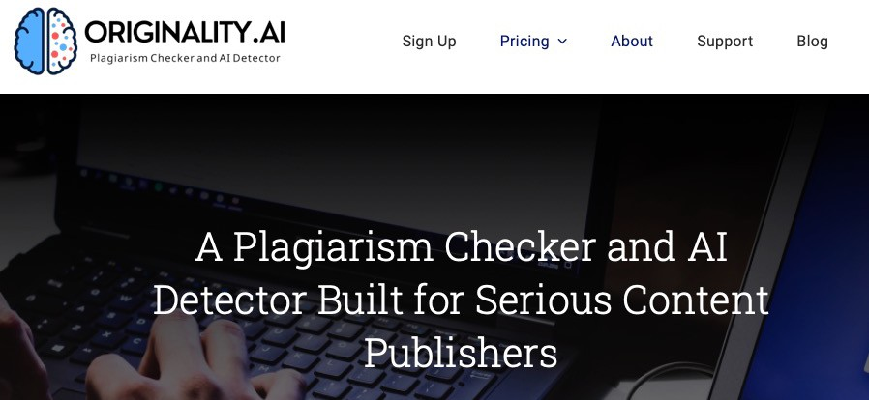
Detecting AI in Assignments/Assessments
Problem
ChatGPT writing is as original as human writing (if not more so)
Does not follow obvious patterns
Upcoming Solutions
Many solutions emerging recently
Watermark system being developed by OpenAI (pseuorandom selection of tokens)
TurnItIn, Originality.AI, Packback, and more

Slide 31
Academic Integrity Discussion
Definitions of Cheating, Plagiarism, Dishonest behavior
University Policies/procedures
Syllabus Statement

Slide 32
Resources
Heikkila, M. (2022) How to spot AI-generated text. Technology
Review. https://www.technologyreview.com/2022/12/19/1065596/how-to-spot-ai-generated-text/
McMurtrie, B. (2023, January 5). Will CHATGPT change the way you teach? The Chronicle of Higher Education. Retrieved January 9, 2023, from https://www.chronicle.com/newsletter/teaching/2023-01- 05?cid2=gen_login_refresh&cid=gen_sign_in
Mollick, E. R., & Mollick, L. (2022). New Modes of Learning Enabled by AI Chatbots: Three Methods and Assignments. https://papers.ssrn.com/sol3/papers.cfm?abstract_id=4300783
Shatten, J. (2022). Will artificial intelligence kill college writing. The
Chronicle. https://www.chronicle.com/article/will-artificial-intelligence-kill-college-writing
Sumakul, D. T. Y., Hamied, F. A., & Sukyadi, D. (2022, February). Students’ Perceptions of the Use of AI in a Writing Class. In 67th TEFLIN International Virtual Conference & the 9th ICOELT 2021 (TEFLIN ICOELT 2021) (pp. 52-57). Atlantis Press. https://www.atlantis-press.com/article/125970061.pdf

Slide 33
Additional Links
Detection
Turnitin: https://www.turnitin.com/blog/ai-writing-the-challenge-and-opportunity-in-front-of-education- now
https://originality.ai
Business Insider: https://www.businessinsider.com/app-detects-if-chatgpt-wrote-essay-ai-plagiarism-
2023-1

