Slide 1

10 things you should know about the penn state library
Penn State Scranton
New Student Orientation
Summer 2022
Notes:
Penn State Scranton
New Student Orientation
Summer 2022

Slide 2
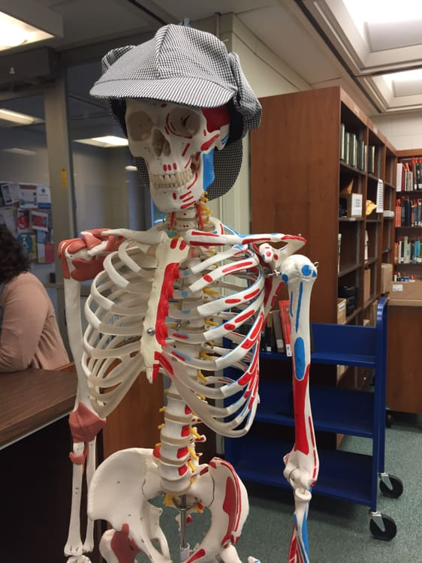
Equipment available in the library
1
We have laptops, scientific calculators, portable chargers, noise-canceling headphones, and even a skeleton you can borrow.
The students named our skeleton. Meet Sherlock Bones!

Slide 3

Textbooks available
2
We have copies of many textbooks available to borrow for 2-hour in-library use

Slide 4
Scholarly information
3
Most high quality, scholarly information is not available for free on the Internet, but it is through the library’s website!

Slide 5
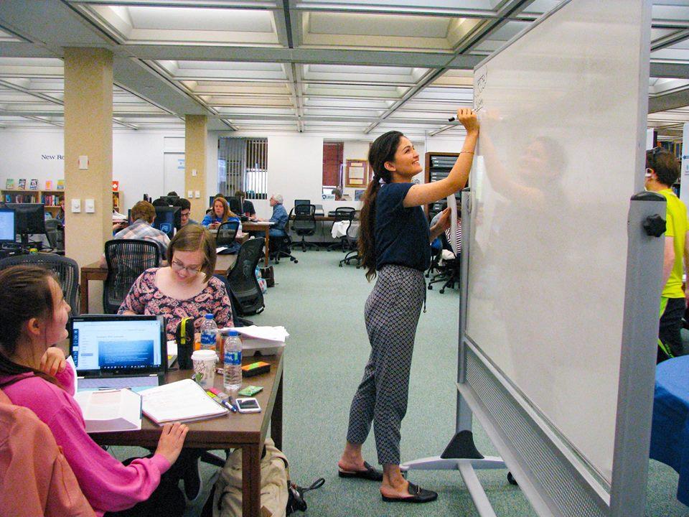
Study spaces
4
We have great study spaces, including group study rooms

Slide 6
Electronic journals online 24/7
5
We are online 24/7 with electronic journal articles and e-books

Slide 7
DVD Books and magazines
6
We also want you to find time to relax. We have DVDs, popular books, and current magazines.

Slide 8
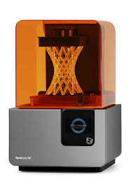
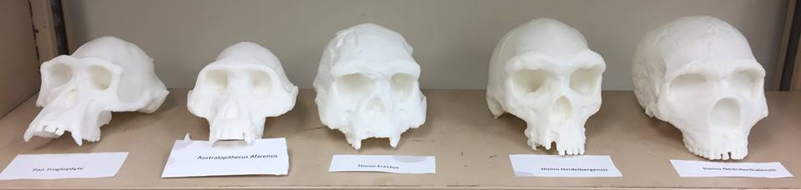
3-D printer
7
Experimentation is important for learning. That’s why we have a 3D printer for you to test out your new ideas.

Slide 9
Books for leisure reading
8
Yes, we have books, too. Reference, scholarly, and leisure reading. And if we don’t have what you’re looking for on campus, we can usually have it in Scranton within 2 days!

Slide 10
printers
9
One of the campus's three printers is located in the library building

Slide 11
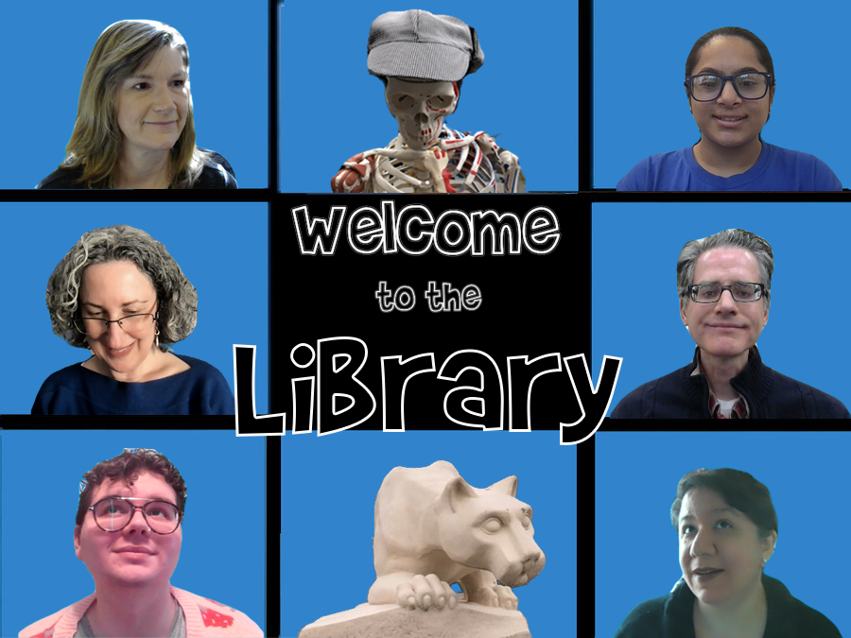
Our staff
10
We have helpful library staff who want you to succeed, and provide research assistance via text, chat, phone, email, and in-person consultations
Notes:
Inspiration for this presentation concept taken from Nicole Eva, “Pecha Kucha It: Everything You Need to Know About the Library in Six Minutes and Forty Seconds,” Planning Academic Library Orientations, 2018. pp. 335-339.

